Slide 1
Training Approaches to Develop Evaluators

Slide 2
Learning Objectives
At the end of this session, participants will be able to:
Describe the evaluator roles and responsibilities
Describe the skills and abilities required to be an evaluator of HIV-RT personnel competency
Distinguish between acceptable and unacceptable practices when conducting a personnel competency assessment.
Understand the training approach for personnel evaluators.

Slide 3
Evaluator Role and Responsibilities
Coordinate personnel competency assessments and corrective actions
Conduct competency assessments
Provide feedback to Testers and Supervisors
Mentor Testers
Train other Evaluators (Master Evaluators)
Enter and Analyze Data

Slide 4
Evaluator Role and Responsibilities Exercise
Evaluator Roles and Responsibilities | Associated Evaluator Attributes
Coordinate personnel competency assessments and corrective actions
Conduct competency assessments
Provide feedback to Testers and Supervisors
Mentor Testers
Train other Evaluators (Master Evaluators)
Enter and Analyze Data
Good organization
Good conflict management
persistent
Good time-management
Self-reliant
observant
Detail oriented
Good time-management
decisive
Effective communication
Good conflict management
motivational
encouraging
Good listener
patience
analytical
instructional
patience
Detail oriented

Slide 5
Attention
to detail
Trained
Diplomatic
Technical/
Quality
management
expertise
Communicate
effectively
Important
Skills
for Evaluators
Notes:
5

Slide 6
Technical and Quality Management Expertise
Evaluators must:
  Have at least a general knowledge of safety, infection control, and key components of quality assurance
  Possess technical knowledge related to the current national HIV-RT algorithm
  Understand quality assurance cycle concepts, personnel competency assessment tools, database management, and corrective action (remediation)
  Demonstrate a track record of appropriate knowledge and skills related to a healthcare setting

Slide 7
Diplomacy and Professionalism
Evaluators must be diplomatic and professional:
  Respectful of others
  Ethical (i.e., fair, truthful, sincere & honest)
  Decisive (i.e., timely decision-making using logic, reasoning & critical analysis)
  Self-reliant (i.e. function independently while interacting effectively with others)
  Maintain confidentiality
  Objective (unbiased, impartial)
  Ensure cultural sensitivity in all environments
  Communication:
    Encourage or discourage; sooth & heal or crush & destroy
    Address issues not personalities
    Demonstrate investment in ensuring maintained personnel competencies by offering constructive feedback and remediation planning

Slide 8
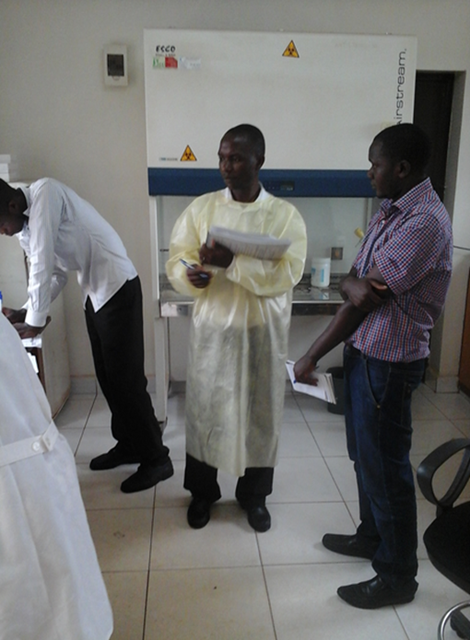
Evaluators Skills & Abilities
Evaluators must:
  Interpret and apply the appropriate direct observation checklist to different personnel competency assessment situations
  Be able to collect relevant, reliable, factual evidence from observing personnel and surroundings
  Observe effectively
  Be very detail focused
  Exercise sound judgment & analytical skills
  Demonstrate investment in ensuring maintained personnel competencies by offering constructive feedback and remediation planning

Slide 9
Areas of Application for Skills and Abilities
Coordinate personnel competency assessments at testing sites/points
Conduct a personnel competency assessment fairly and without fear or favor
Effectively communicate - oral & written to ensure achievement of personnel competency assessment objectives
Evaluating personnel competency assessment observations and interactions to arrive at logical conclusions
Avoiding distractions and managing time
Control conflict with others and managing stressful situations
Withstanding pressure to change views to ones not based on objective evidence
Effectively assess and solve problems

Slide 10
The many faces of Communication:
How we send and how we receive messages
What we say and others hear
What others say and we hear
How we communicate with :
  Ourselves
  Our Family
  Our Colleagues
  Our mentors and teachers
  Strangers…
…may differ considerably

Slide 11
Effective Communication
What is said may not be what is heard
  Choose words carefully
  Observe how they are received
What is heard may not be understood
  Engage in discussion to ensure understanding
What is understood may not be accepted
  The tester may be defensive during the competency assessment

Slide 12
80% of Communication is Non-Verbal
Body Language
  Posture
  Eye contact
  Arm position
Facial Expression
  Eyes
  Mouth
Voice intonation
Overall attentiveness
Communication is give and take … what non‐verbal body language are YOU sending?

Slide 13
Evaluators Practice Reflection to Continuously Improve
Description
What
happened
Action Plan
Feelings
If it arose
again what
would you do
What were
you thinking
and feeling
Reflective
Practice
Conclusion
Evaluation
What else
could you
have done
What was
good
and bad
about the
experience
Analysis
What sense
can you make
of the experience
Continuously learning from experience…..

Slide 14
Evaluator Dos & Don’ts
Do:
  Give compliments when deserved
  Encourage staff to achieve competency objectives
  Be fair to all
  Use respectful and tactful language to give feedback
  Remember that quality is generally about systems/protocols/habits and not personalities
  Remember that personnel competency assessments are to ensure improved reliability and better patient care

Slide 15
Evaluator Dos & Don’ts
Don’t:
  Focus on insignificant issues
  Attempt to ‘catch lab staff out’
  Intimidate and ‘talk down’ to staff
  Try to find only ‘what’s wrong’ and ignore ‘what’s right’
  Stimulate conflict
  Be prescriptive and dogmatic (i.e., only your view counts)
  Give unclear feedback
  Base observations on information that has not been validated

Slide 16
Training approach

Slide 17
Cascade Training Approach
ToT
Stepdown
(Training of Trainers)
Evaluators
Master Evaluator/Trainer
Evaluators
RTCQI POC-Facilitator
Country CDC/IPs/MoH
Evaluators
(ILB)
Master Evaluator/Trainer
Evaluators

Slide 18
TOT Agenda Overview
Day 1
  Pre-training written assessment
  In-depth didactic and hands-on training about the personnel competency assessment tools and the role/expectations of an evaluator
Days 2 & 3
  Practical examples and group work related to evaluator role
  Field practical assessment sessions to cultivate and ensure successful observation and assessment practices during actual HIV-RT personnel competency assessment
  Facilitator feedback and open discussions

Slide 19



Practical Examination for Evaluators
During TOT
Facilitator
direct observation of HIV-RT
Peer-to-peer observation
Participant 1
(prospective Evaluator)
Participant 2
(prospective Evaluator)
direct observation of HIV-RT
Tester 1

Slide 20

Practical Examination for Evaluators
During TOT
Facilitator
direct observation of HIV-RT
Peer-to-peer observation
Participant 1
(prospective Evaluator)
Participant 2
(prospective Evaluator)
direct observation of HIV-RT
Tester 2

Slide 21
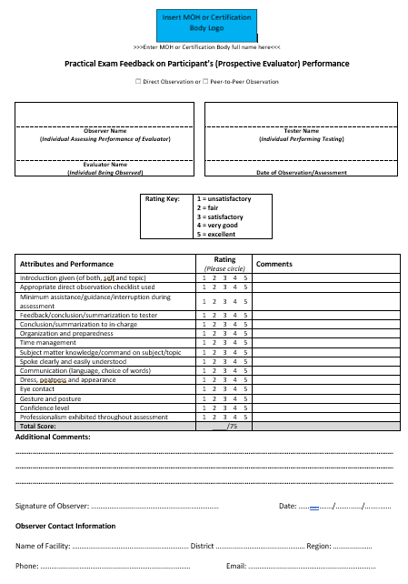
Practical Exam Feedback Form
(Rate Evaluator’s Performance)

Slide 22
TOT Agenda
Day 4
  Post-training written assessment
  Preparation and group report backs on field practical sessions
  Facilitator feedback
  Open discussion
  Written examination administration
  Implementation strategy for roll-out
  Workshop evaluation
  Closing ceremony and certification

Slide 23
Evaluation Criteria for Participants
CRITERIA | SCORING
 | LEVEL 1 | LEVEL 2 | LEVEL 3 | LEVEL 4
 | <70% | 70-79% | 80-89% | ≥90%
Attendance
Pre-Training Written Assessment
Training Content Comprehension
Competency Assessment Skills -Practical
Computer Skills / Data Management Comprehension
Post-Training Written Assessment

Slide 24
Competency Levels for Participants
OVERALL COMPETENCY LEVELS Levels 1 – 4 | Level 4 Potential trainer and evaluator of personnel competency. Ready to facilitate and conduct competency assessment using both direct observation checklist and peer-to-peer observation form
 | Level 3 Needs more development as a facilitator and/or an evaluator. Should work under the guidance of more experienced evaluators.
 | Level 2 Does not have acceptable facilitation and/or evaluation skills, but understands the training package well and has inter-personnel skills. May be able to use the checklist to identify deficiencies in personnel competency.
 | Level 1 Cannot facilitate or conduct competency assessment. May be able to assist with logistic support or data management for the QAC. May be able to serve as proctor for written examination.

Slide 25
Summary
What are the skills and abilities required to be an evaluator?
What are some acceptable and unacceptable practices when conducting a personnel competency assessment?
What can evaluators do to strive to continually improve?

